Slide 1

Final project presentation:
Berlin, 09.08.2022
Stephanie Fosso
& Weiling Peng
How popular will your video be on YouTube?
1 of 10
www.wbscodingschool.com

Slide 2
problems
solution
CHALLENGES
Agenda
2 of 10
www.wbscodingschool.com

Slide 3


A data-based solution project for – Miguel
Miguel has 2 problems
Hope to get videos popular/trended
Spend hours every day to read comments from audience
3 of 10
www.wbscodingschool.com

Slide 4
A data-based solution project for – Miguel
Miguel has 2 problems
Spend hours every day to read comments from audience
Hope to get videos popular/trended
4 of 10
www.wbscodingschool.com

Slide 5
problems
solution
CHALLENGES
Agenda
5 of 10
www.wbscodingschool.com

Slide 6

Big data shows a better channels
–
Pets & Animals
💪
New positioning channel
Current channel
6 of 10
www.wbscodingschool.com

Slide 7
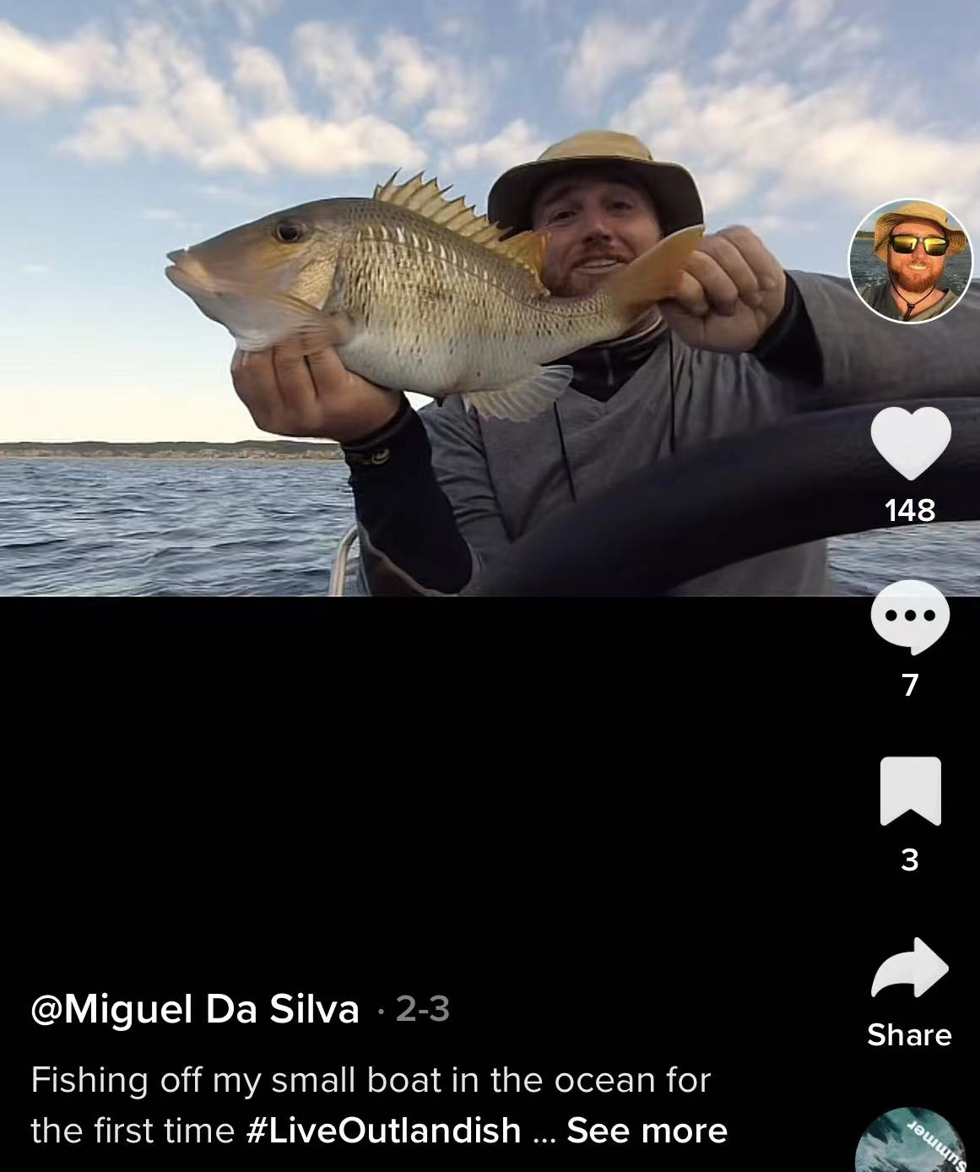

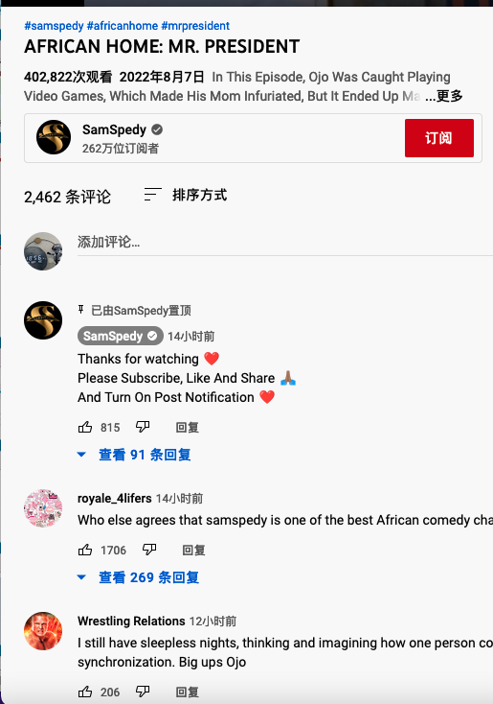
Data-based solution -
get popularity prediction before posting video
Title
Prediction score: 84%
Tag
Description
channel
category
7 of 10
www.wbscodingschool.com

Slide 8
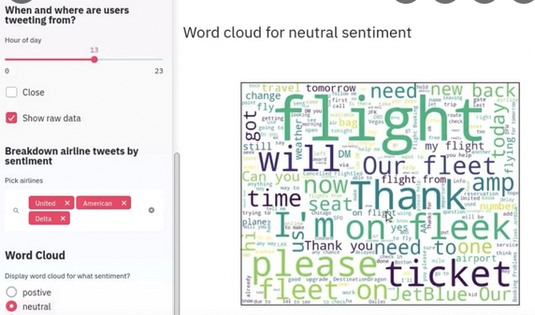
Data-based solution - ML tool to help you save time
8 of 10
www.wbscodingschool.com

Slide 9
problems
solution
CHALLENGES
Agenda
9 of 10
www.wbscodingschool.com

Slide 10

Straight way solution-
Let’s keep up-to-date
Personalization: user watch history and action
Performance: interest in watching the video, view duration, satisfaction
External factors: topical interests, how your competition is performing,
relevancy to the current season
……..
10 of 10
www.wbscodingschool.com

Slide 11

Thank you
&
happy Youtubing : )
11 of 11
www.wbscodingschool.com

